Slide 1

Unit 4:Cognitive Radio Networks
Preeti Godabole

Slide 2
Contents
Fixed and dynamic spectrum access;
Direct and indirect spectrum sensing;
Spectrum sharing;
Interoperability and co-existence issues;
Applications of cognitive radio networks.

Slide 3
What is CR
Cognitive radio (CR) is a form of wireless communication in which a transceiver
intelligently detect which communication channels are in use and which ones are not.
The transceiver then instantly moves into vacant channels, while avoiding occupied ones.
Helps to optimize the use of the available radio frequency (RF) spectrum.
minimizes interference to other users, by avoiding occupied channels, it increases spectrum efficiency and improves the quality of service (QoS) for users.

Slide 4
Wireless RF spectrum
It is a limited resource, allocated through a licensing process
The allocated (licensed) spectrum is not always used optimally.
Some bands are overcrowded (e.g., GSM cellular networks), others are relatively unused (e.g., military).
spectrum inefficiency limits the amount of data that can be transmitted to users and lowers service quality.
Cognitive radio is an efficient way to use and share this resource intelligently, optimally and fairly.

Slide 5
cognitive radio network (CRN)
CRN has two main networks, a primary network and a secondary network.
The primary network owns the licensed band and consists of the primary radio base station and users.
The secondary network shares the unused spectrum with the primary network. It consists of the cognitive radio base station and users.
The three key capabilities that differentiate cognitive radio from traditional radio are:
Cognition: CR understands its geographical and operational environment.
Reconfiguration: CR can decide to dynamically and autonomously adjust its parameters.
Learning: CR can also learn from the experience, and experiment with new configurations in new situations.

Slide 6
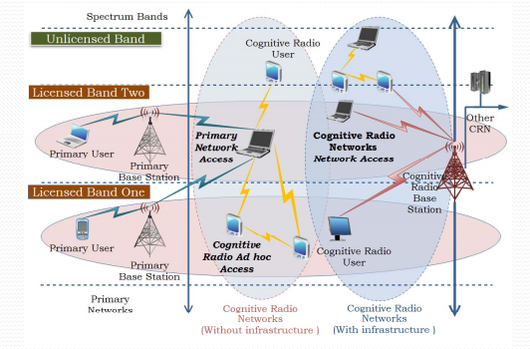

Slide 7
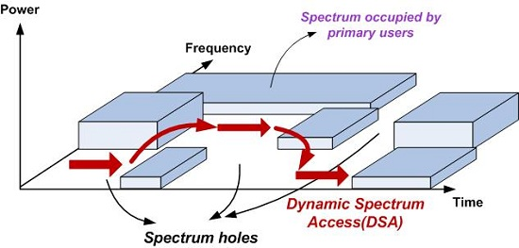
Spectrum Holes

Slide 8
Cognitive radio facets
spectrum sensing
CR devices track the spectrum bands in their neighborhoods to identify users licensed to operate in that band.
look for unused portions of the RF spectrum known as white spaces or spectrum holes.
These holes are created and removed dynamically and can be used without a license.
spectrum database
TV stations update their next week’s use of the RF spectrum in a database that the FCC maintains. Cognitive radio devices can seek information about free spectrum from this database

Slide 9
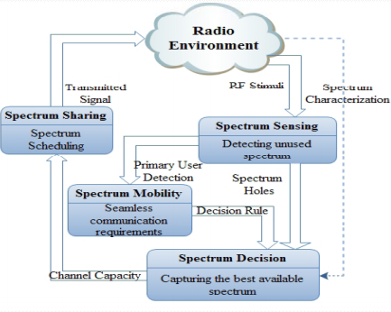
CRN Life cycle

Slide 10
spectrum sensing is that the secondary users have to detect the presence of the primary users in the licensed spectrum and quit the frequency band as quickly as possible if the corresponding primary radio emerges so that the primary user does not face any interference.
. The Spectrum sensing techniques are classified into 3 main types,
Transmitter Detection (Non Cooperative Sensing),
Cooperative Sensing and
interference based testing

Slide 11
Applications of CRN
CR is a disruptive new technology with many potential applications. This is why it is also known as a next-generation communication network.
For example, CR can help address connectivity problems in rural areas. It can also optimize RF operations for smartphones and IoT devices, content delivery networks, also known as content distribution networks, and giant wireless hotspots.

Slide 12
Types of CRN
heterogeneous
In heterogeneous CR, operators run several radio access networks (RANs) using the same or different radio access technology (RAT) protocols.
Heterogeneous cognitive radio uses a network-centric approach, and the frequency bands allocated to the various RANs are fixed
spectrum-sharing
Several RANs share the same frequency band.
They also coordinate with each other to use unoccupied sub-bands intelligently and optimally.

Slide 13
DSA
The technique of dynamically accessing the unused spectrum band is known as Dynamic Spectrum Access (DSA). The dynamic spectrum access technology helps to minimize unused spectrum bands.
To regulate the use of this limited resource, fixed spectrum access policy (FSA) was adopted by spectrum regulators. Under this policy, a fixed piece of spec- trum is assigned for a dedicated purpose which is further distributed to the users for access to wireless services.

Slide 14
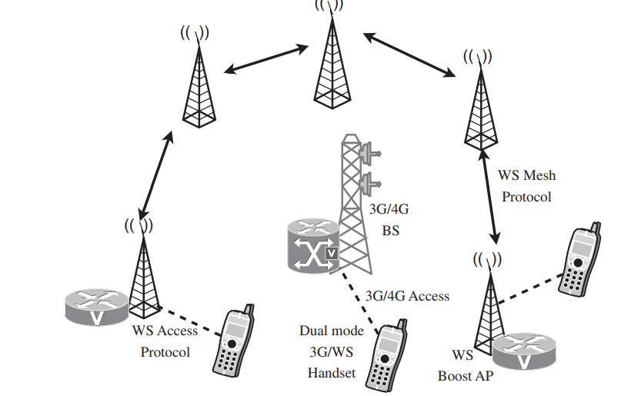

Slide 15
cognitive radios : alleviate high loads on the cellular network.
an overlay mesh network of white space hot-spots can carry non-real-time or delay tolerant data like mail, content, file transfer, etc.
The hot-spots can operate either in the licensed or unlicensed band. Off-loading part of the delay tolerant data traffic from the cellular network helps operators to meet the quality of service (QoS) requirements of delay.
The boost in the capacity comes at no additional cost, but from the detection of available white spaces and the opportunistic transmission over white spaces using the hot-spot mesh network

Slide 16
Issues in CRN
Interoperability challenges
– CRN based device-to-device communications
– CRN based device-to-network communications
– CRN based machine-to-machine communications
– CRN based service-to-service communications
Co-existence network technologies challenges
– CRN based radio access
– CRN based medium access control (MAC)
– CRN based handover between multiple communication standards
– CRN based channel hopping

Slide 17
Communications
M2M communications refer to automated applications which involve machines or devices communicating through a network without human intervention.
Device-to-Device (D2D) communication refers to a radio technology that enables devices to communicate directly with each other, that is without routing the data paths through a network infrastructure.
The client can make a REST call to interact with other services. The client sends a request to the server and waits for a response from the service (Mostly JSON over HTTP). <Service to service>

Slide 18
Applications of CRN
It allows constructing a network of radio stations with the combination of cognitive radio nodes hence gives significant boost to the speed and availability of channels for the new secondary wireless networks.
There are two possibilities to access vacant channel.
One, CR contact to multiple non CRs transmissions where femtocells get cognitive inspection, erect and then communicate with non CR mobiles.
Two, CR networks would like to contact to the network and operate through the cognitive radio network.

Slide 19
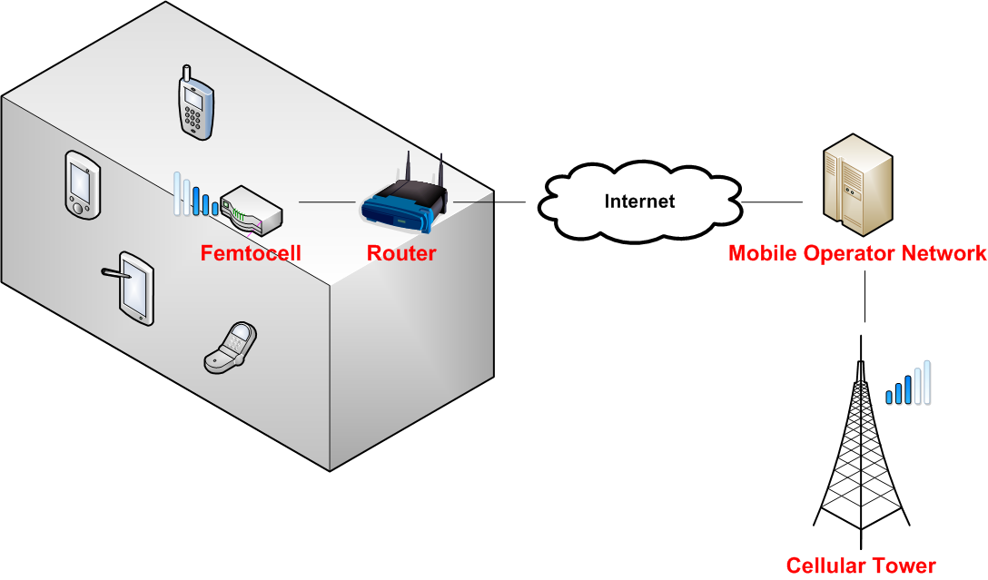
Femto Cells
In telecommunications, a femtocell is a small, low-power cellular base station, typically designed for use in a home or small business. A broader term which is more widespread in the industry is small cell, with femtocell as a subset.

